Slide 1
The Observer Design Pattern
By Bradley Woods

Slide 2
Pattern Overview
Consists mainly of subjects and observers.
  Subjects update all observers on state changes.
  Observers query the subject after receiving an update.
Subject can have any number of observers
  Observers can be added and taken away dynamically

Slide 3
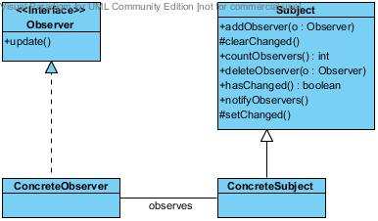
Pattern Illustration
*
0-1

Slide 4
Observer in Java
The Java class libraries include the Observer interface and the Observable class.
Easy to use/implement
  Observer interface has one method
  Child classes of Observable (the subject) inherit all necessary methods

Slide 5
Pros
Decoupling
Simplicity
Information Hiding
Cons
Restrictions from decoupling
Conflicts with layered architecture
Overabundance of notifications
Unwanted data

